Slide 1


Personalizing your store of the future
Accelerate retail transformation end to end

Slide 2


The retailer's challenge
Five retail imperatives
As the economy emerges from the COVID-19 pandemic and new demographic and technological shifts become the norm, organizations must be agile enough to respond to evolving customer expectations.
From fixed point of sale systems to fully-autonomous shopping experiences, each retailer will be at a different stage on their transformation journey. Yet each will share common goals – to delight consumers, drive efficiencies and open up new revenue-generating opportunities.
And each will face a similar challenge – to securely manage end-to-end infrastructure while grappling with budget, legacy IT and integration constraints.
At SUSE, we believe that transformation can be enhanced and accelerated by open innovation. The most successful businesses will be those that capitalize on interoperable solutions that let them harness modernization, no matter where it occurs. For retailers, in other words, it will be those that can unlock technological potential in order to create their store of the future.
Agility and flexibility: Post-pandemic, customer expectations continue to evolve. In order to provide the best experiences possible, further tech implementation is a must. This requires a flexible core.
01
02
Retail at the Edge: Going digital is not enough. It's now about consumer experience differentiation and, much of that will happen at the Edge, at the closest point to the customer.
03
Cost transformation: Running an omni-channel operation and assigning capital to further innovate means cost efficiency will be at the heart of future organizational strategy.
_{85%}
of retailers are actively pursuing digital transformation, which means simply "doing digital" is not enough to stand out.
www.bdo.com
04
Resilience: Retailers need to power super-fast transactions and up-to-the-minute insights. As a result, business-critical applications, such as SAP, need to stay up and running around the clock.
05
Security: As retail infrastructure becomes digitized end-to-end, protection of operational technology, intellectual property and customer information is imperative.

Slide 3

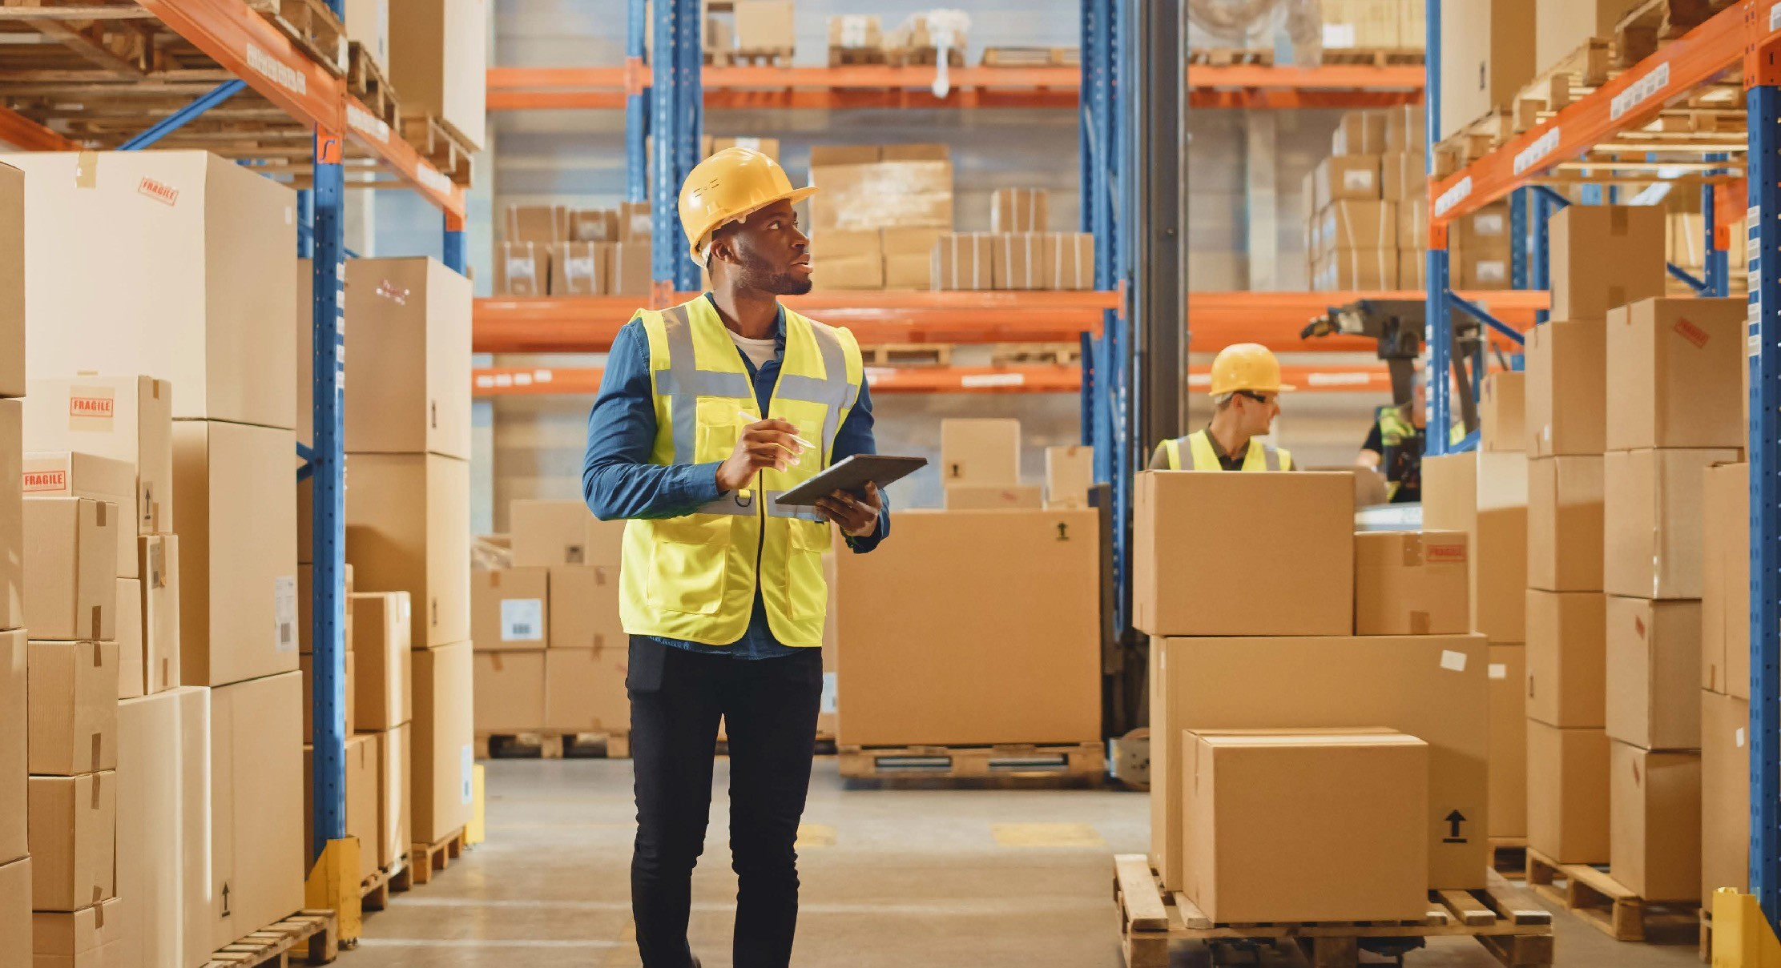
How to meet the retail imperatives
SUSE offers:
1. Infrastructure versatility
Retailers, seeking to drive rapid digital transformation in order to build differentiating omni-channel customer experiences, remain concerned by the lack of agility and lock-in offered by legacy IT infrastructure solutions.
How SUSE can help: SUSE Manager for Retail delivers best-in-class open -source infrastructure management. SUSE Harvester futureproofs and modernizes the technology stack, while SUSE Linux Enterprise Server is the preferred platform for SAP customers.
End-to-end customer experience transformation
To drive growth, retailers must deliver personalized, reliable, seamless and differentiated customer experiences. Integrating new technologies and supporting scale is a must.
How SUSE can help: SUSE Linux Enterprise Server15 SP3 allows retailers to deploy and leverage the newest point of sales (POS) systems. SUSE Rancher and K3s light-weight Kubernetes oversees production workloads across resource-restrained, remote locations or on IoT devices. SUSE’s GitOps-driven continuous delivery capability manages multiple Edge-based clusters..
Infrastructure management optimization
Accelerated technology adoption is often slowed by monolithic legacy systems which are hard to change. Those looking to deploy radical transformation strategies know the importance of end-to-end infrastructure management.
How SUSE can help: SUSE Manager for Retail scales to tens of thousands of end point devices and beyond. SUSE Rancher provides a comprehensive management view, simplifying and optimizing the management of Edge, POS and other technologies across retail infrastructure.
_{80%}
Only by selecting the best-of-breed technology and supporting agile, secure and optimized infrastructure can retailers deliver on the promise of end-to-end transformation. That's why key sector players look to SUSE for comprehensive, open-source solutions.
of executives believe consumers will prioritize stock availability over retailer loyalty.
www2.deloitte.com

Slide 4




Why SUSE?
Business-critical Linux
Run workloads across cloud and on-premises.
Benefits: Accelerates innovation and enables faster market response.
Enterprise Container Management
Orchestrate containerized applications.
Benefits: Maximizes development agility and unifies clusters to ensure consistent operations workload management, and enterprise-grade security – from core to cloud to Edge.
_{40%}
Office Depot's modernization program saved over 40% in IT management costs.
SUSE
Run SAP
Delivers mission-critical SAP solutions.
Benefits: Reduces service outage risks and deploys SAP services faster on-premises and in the cloud.
IT Operations at the Edge
Deploy intelligent devices at the network Edge.
Benefits: Consistency, performance, reliability, security – all vital for manufacturing Edge use cases.

Slide 5

Security embedded
Stay ahead of the curve with SUSE:
SUSE provides a foundational layer of security and resilience across critical systems to overcome the increased risk of exposure that accompanies digital transformation. For retailers, that means embedded security across applications end to end. SUSE also provides a framework for compliance with internal policies and external regulations.
_{80%}
Retail executives are defending 80% of targeted attacks and experiencing 32 security breaches a year, slightly more than the global average.
Accenture
01
Provides the backbone that allows retailers to innovate at pace
02
Continuously evolves products and services to align to the latest technology
03
Prevents vendor lock-in with integration-ready solutions
04
Enables ease and speed of adoption with interoperable open architecture
05
Offers trusted security and stability

Slide 6

How we're already transforming the retail industry
C&A
Accelerating business analytics and staff productivity
Find out more
Carrefour
Powering super-fast transactions and up-to-the-minute insights
Find out more
With SUSE, you are a step closer to realizing your store of the future. As an open-source Edge solutions provider, we support retail customer experience transformation by enabling agile, secure and optimized infrastructure.
Office Depot
Reducing IT management costs by 40%
Find out more
Find out how SUSE can help your organization on our retail web page.

